Slide 1

Applied Distributed Systems
Measurement of running systems

Slide 2
Overview
Why measure?
Utilization
Logging
Tracing

Slide 3
Measurement
After a system is in operation, measurement information is gathered for three purposes:
Alerting – Detecting that there is a problem
Forensics – determining what caused a problem
Improvement – finding bottlenecks in systems or determining causes of internet traffic.

Slide 4
General picture
Running system
Backend
Measurements
Measurements are taken from a running system and its environment and sent to a back end.

Slide 5
Back end
The back end has a data base (usually a time series database). It
Generates alerts
Generates reports
Allows drilling down into aggregate information to get more detailed information
Has a dashboard to give fast indication of problems.

Slide 6
Overview
Why measure?
Utilization
Logging
Tracing

Slide 7
Utilization
Utilization is measure of some activity over some period of time
Collected automatically by infrastructure over externally visible activities of VM
CPU – percentage busy
I/O – amount of traffic
etc
Collected by back end from infrastructure

Slide 8
Utilization measures
Taken over period of time
Instantaneous measurement is not meaningful.
At any instant a CPU is either busy or idle.
You want to know whether the CPU is overloaded. I.e. what percentage of the last five minutes (for example) was the CPU busy

Slide 9
Alerts
Back end has set of rules to establish when to send an alert. E.g. alert if CPU utilization is over 80% for 15 minutes.
Utilization numbers are bursty. The period must be sufficiently long to indicate problem.
False positives and false negatives are both problems.
An alert causes a page to be sent.

Slide 10
Overview
Why measure?
Utilization
Logging
Tracing

Slide 11
Logs
A log is an append only data structure
Written by each software application.
Located in a fixed directory within the operating system
Enumerates events from within application
Entry/exit and associated parameters
Troubleshooting
DB modifications
…

Slide 12
Log Daemon
A daemon resides on each server.
It copies logs generated by applications on that server to back end.
Logs can be voluminous and so daemon may also clean off log file periodically – once the contents have been sent to the back end.

Slide 13
What happened?
Logs are used to determine what happened.
Either
immediately after an alert to get the system working again or
later to determine frequent types of problems and their causes

Slide 14
Overview
Why measure?
Utilization
Logging
Tracing

Slide 15
Tracing
Tracing provides an end to end picture of a request.
Utilization helps determine whether there is a problem.
Logging provides picture of a single event
Tracing provides a sequence of events
Tracing is used to understand the big picture

Slide 16
Spans
A trace captures the end to end actions in response to a user request.
A span is a named, timed operation that represents a piece of the trace.
Spans may have child spans
Displaying spans on a time axis allows you to see:
Parallelism
Where time is being spent

Slide 17
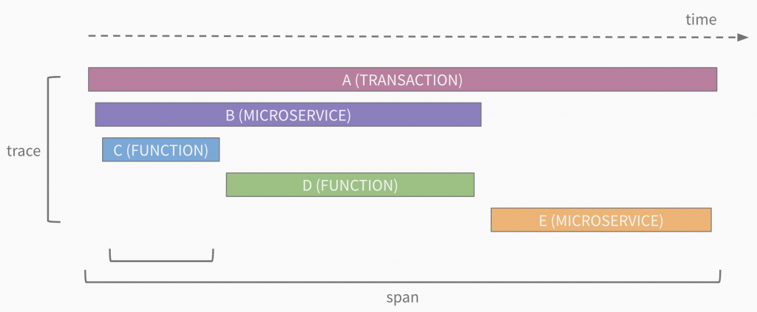
Sample span display*
*https://sflanders.net/2019/03/28/an-intro-to-distributed-tracing/

Slide 18
How does tracing work? - 1
This is one of many possible implementations.
Request enters the system from external source – user or external system
Request is given a unique ID that reflects the context
Context description is kept in a data base so that with context ID analyst can know details of the context.

Slide 19
How does tracing work? – 2
Context id becomes a portion of HTTP header. World Wide Web Consortium is standardizing how this will work.
The context ID is inserted by the HTTP server accepting the request and propagated by every service as it fans out the request. This is transparent to the requester.
Context can be used to control behavior of a service.

Slide 20
Examples of context
Test version. Use context to affect behavior or routing.
Application. Google might want to know what percentage of their network traffic might be due to search, Gmail, etc
Traffic prioritization. Give priority to certain requests to maintain quality of service.
Bottleneck determination. Where is the most time being spent in a collection of transactions?

Slide 21
Summary
Utilization is the measurement of how much the resources in an environment are being used.
Logging is the recording of specific events and information associated with those events.
Tracing ties together a sequence of services.

